Slide 1
04
CAPSTONE
DATA ANALYST

Slide 2
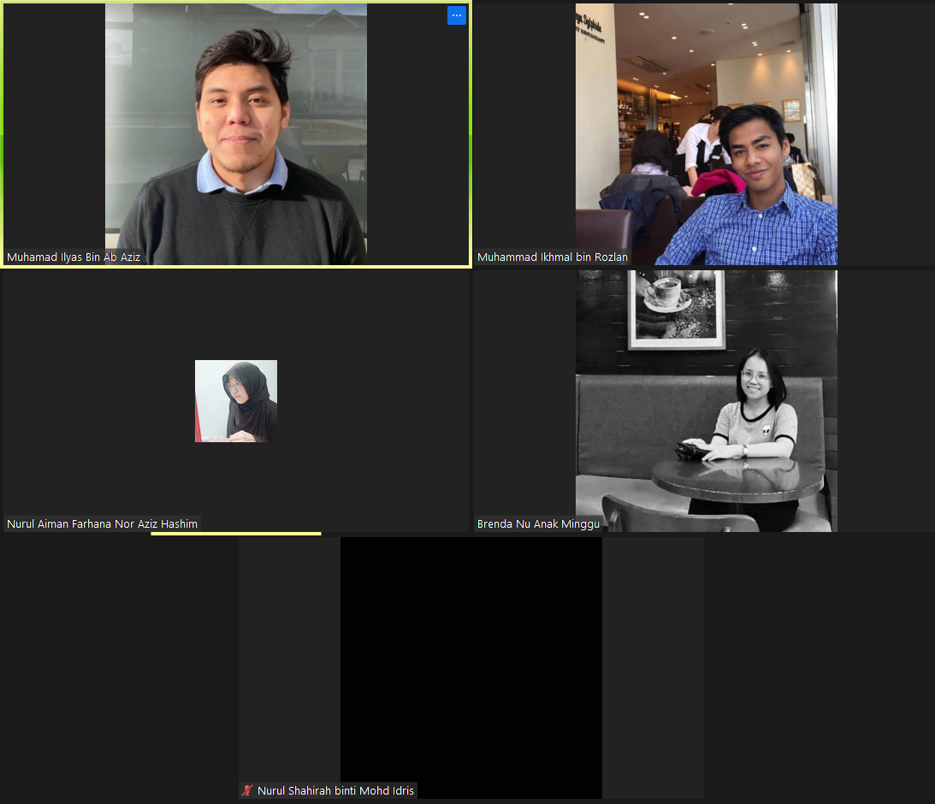
OUR TEAM MEMBERS

Slide 3
BUSINESS PLAN

Slide 4
OUR MAIN OBJECTIVE
The dataset is about customer purchasing history, and focused on determining potential customers. Our objective is to understand the overall performance and to come out with business proposal going forward.

Slide 5
PROBLEM
SOLUTION
Limited knowledge on the performance of each metrics which lead to limited progress on our business
Business proposal that composed of highlighted metrics and relevant suggestions that were analyze and extracted from past several years of data

Slide 6
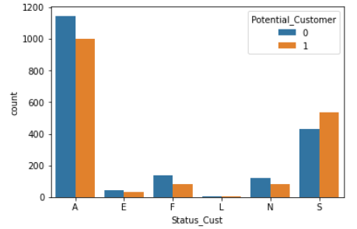
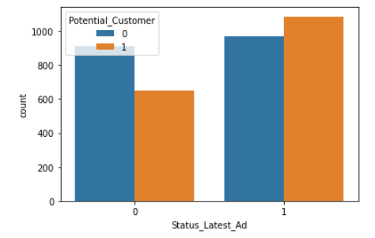
RELATIONSHIP BETWEEN CUSTOMER STATUS AND LATEST ADVERTISEMENT STATUS WITH POTENTIAL CUSTOMER
Active and star buyers has the highest contributions to being potential customers compared to other buyers.
Following the latest promotional sales, there is a rise in the number of potential customers.

Slide 7
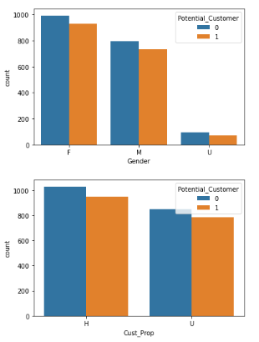
RELATIONSHIP BETWEEN GENDER AND CUSTOMER WHO OWN PROPERTIES WITH POTENTIAL CUSTOMER
Female gender has the highest contributions to being potential customers compared to Male and Unknown gender.
The number of customer who owns a house has the highest contributions to being a potential customers.

Slide 8
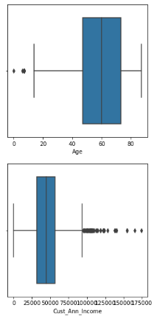
RELATIONSHIP BETWEEN AGE AND CUSTOMER ANNUAL INCOME WITH POTENTIAL CUSTOMER
Based on the boxplot, most of our customers are within the range of 45 to 75 years old.
The annual income for most of our customers are within $30,000 to $55,000.

Slide 9
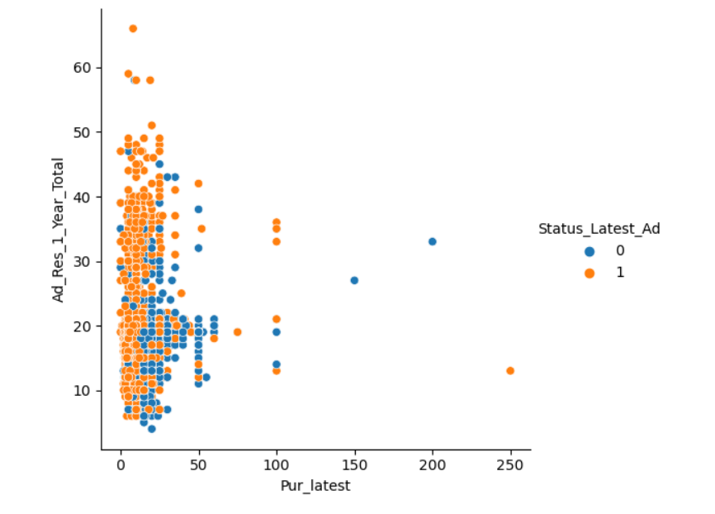
RELATIONSHIP BETWEEN AMOUNT OF PURCHASE AND ADVERTISEMENT FOR PAST 1 YEAR
It can be concluded that the advertisement for the past 1 year is not very effective as compared to the past 3 and 5 years.

Slide 10
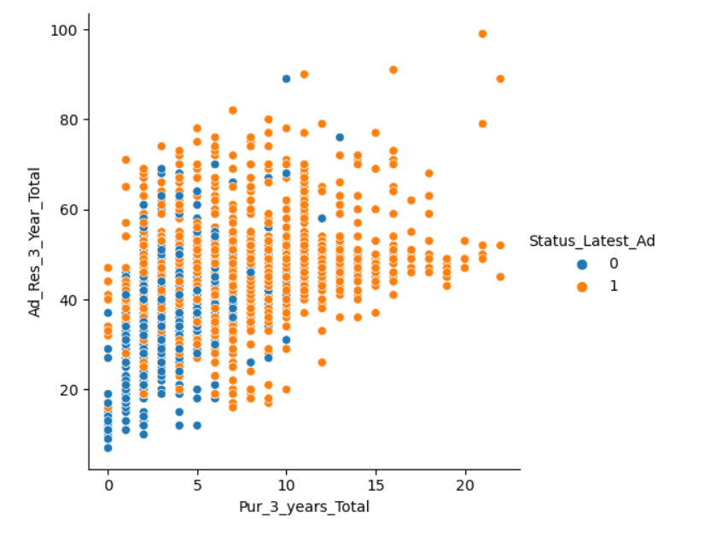
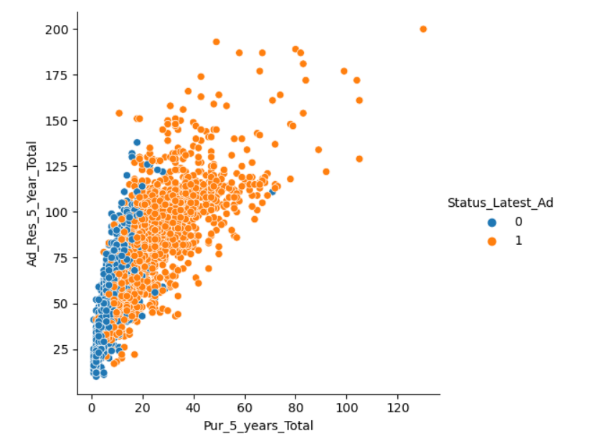
RELATIONSHIP BETWEEN AMOUNT OF PURCHASE AND ADVERTISEMENT FOR PAST 3 AND 5 YEARS
Advertisement is proven effective for the past 3 years and 5 years.
Thus, we can conclude that the current advertisement needs improvement to increase sales.

Slide 11
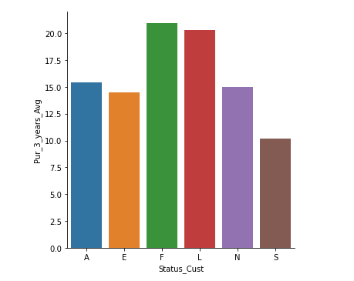
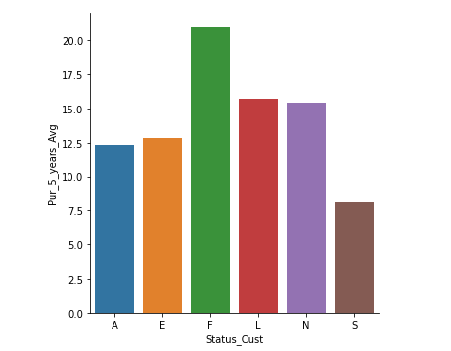
RELATIONSHIP BETWEEN THE AVERAGE NUMBER OF PURCHASE MADE IN THE LAST 3 YEARS AND 5 YEARS AMONG DIFFERENT CUSTOMER STATUS
From the graph we can tell there is shift of status over the years.
This indicates the overall number increases for all customer status.

Slide 12
RECOMMENDATION
Focus on each category separately and try to pinpoint which area to improve on and which area we should maintain.
Main highlight would be conduct some major analysis and improvement for marketing department.
Understand the market pattern better and be more flexible to cater to the ever changing market.

Slide 13
Q n A SESSION :)

Slide 14

Thank you!

